Slide 1
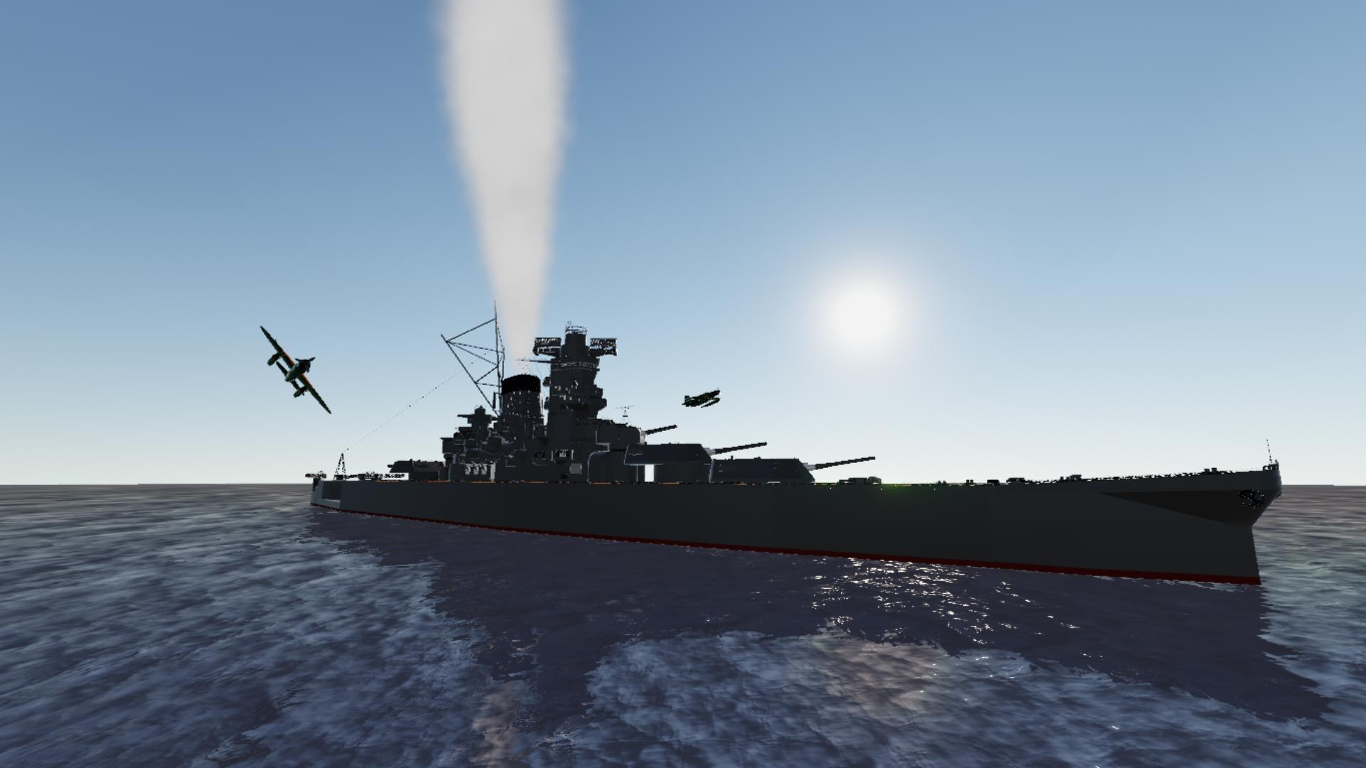

Project 1:
Battleship game
Eric x Ting

Slide 2
Project description:
Objective:
to apply what we have learnt in week 1 and create a game with Python
The game - Battleship:
This is a 2-player guessing game. Your goal is to sink all of your opponent's ships placed on a 10x10 grid by correctly guessing their locations before your opponent sinks all of yours.

Slide 3
Our project workflow:
Plan the project on JIRA
Draw the flowchart of the algorithm
Code the game with many test & recode iterations
Present the game to the class

Slide 4
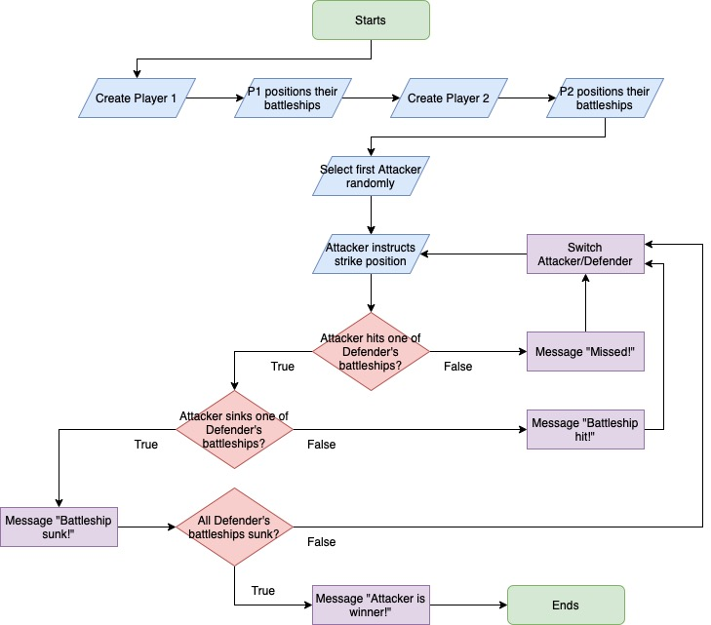
Logic
behind
the
codes:

Slide 5
Challenges encountered:
Tight schedule
Complex conditions involving 2 players
Convert user-friendly coordinates into grid coordinates
Coding logic thinking
Object-oriented programming: very powerful, but complex
Continuous improvement: it never stops!

Slide 6
Demo time!

Slide 7
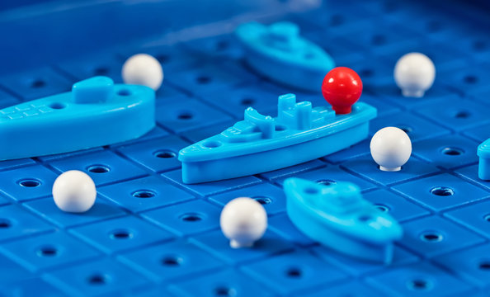
Thank you

